Slide 1
Single Sign On (SSO)

Slide 2
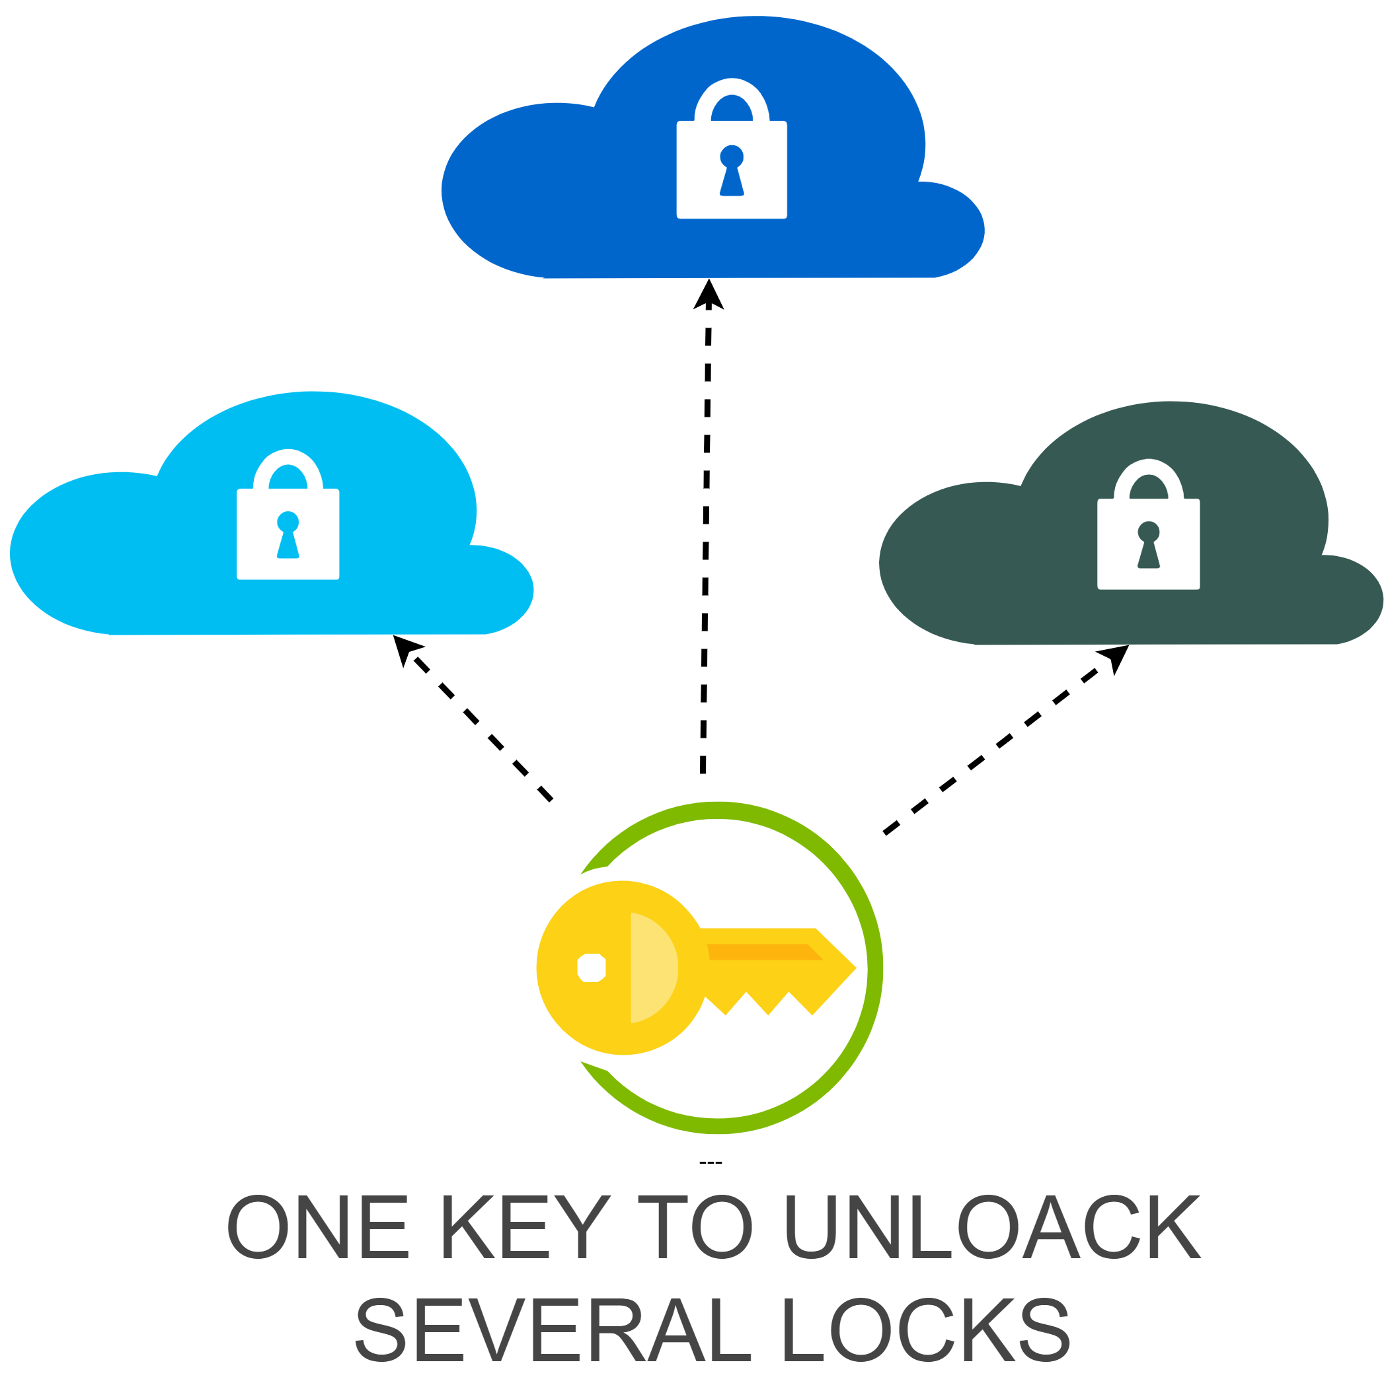
What is Single Sign On?
SSO is an authentication process that allows user to access multiple applications with one set of login credentials
Once a user logs in, he/she does not have to log in repeatedly for every application that is linked in with the system.

Slide 3
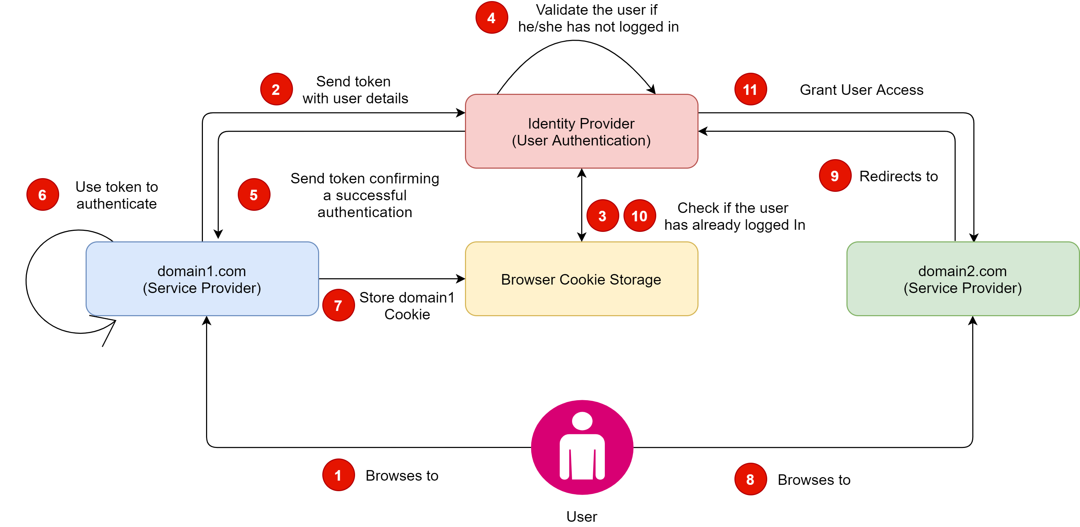
How SSO works?

Slide 4
How SSO works? (Continued)
A user browses a website they want access to, aka, the Service Provider.
The Service Provider sends a token that contains user information, like email address, to the Identity Provider
The Identity Provider first checks if the user has already been authenticated
If the user is not logged in, they will be prompted to provide the credentials required by the Identity Provider.
Once the Identity Provider validates the credentials provided, it will send a token back to the Service Provider confirming a successful authentication.

Slide 5
How SSO works? (Continued)
The token received by the Service Provider is validated according to the trust relationship set up between the Service Provider and the Identity Provider during the initial configuration.
Store the login state in cookies.
User browses another website that they want to access
The Service Provider sends a token with user details to the Identity Provider
The Identity Provider first checks if the user has already been authenticated
If the user has already logged in, Identity Provider grants the user access to the Service Provider application

Slide 6
SSO Token
Is a collection of data or information that is passed from one system to another during the SSO process
Data can simply be a user’s email address and information about which system is sending the token
Tokens must be digitally signed for the token receiver to verify that the token is coming from a trusted source
Certificate that is used for this digital signature is exchanged during the initial configuration process

Slide 7
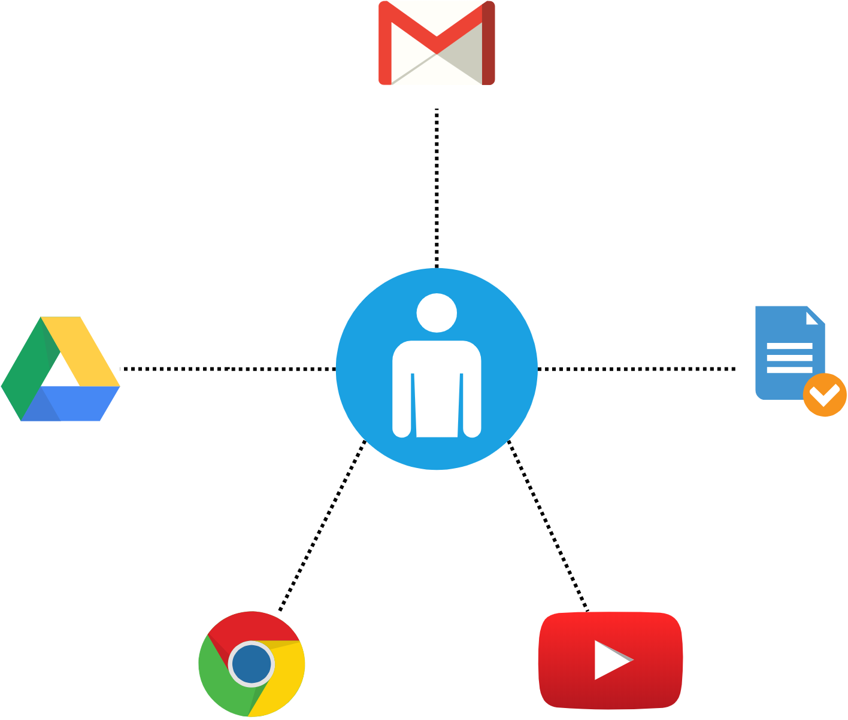
SSO Example
A typical and good example of a single sign on is Google.
Google implements SSO for logging in to their products like Gmail, Drive, Docs, and Chrome.
If a user has logged in to one of their product, then they are automatically logged in to all the Google products.
Whenever a person logs in to a Google product, he/she will automatically be signed into their central service called Google Accounts to log in.

Slide 8
SSO Example
On successfully logged in, the Google accounts generate several authentication cookies and redirect the user to the Application
When the user accesses some other Google service like YouTube, he/she will be first redirected to the same google accounts, which validates their existing cookies and logs in to YouTube

Slide 9
Advantages
Improves user Experience and productivity
- User does not have to log in to multiple applications.
Minimal Passwords to remember
SSO is platform-independent
Stronger Security
- One can implement policies for secure password management or strong authentication.
Reduced support costs
- Lower number of IT help desk calls about password issues.

Slide 10
Disadvantages
Single point of failure:
If the SSO password gets compromised, the security for all the supported applications gets compromised.
Slow Process:
SSO is slower than traditional authentication (User authentication using a database) because, for each login request, the application/website must request the SSO provider for the user verification.
It is impractical in addressing the need for different levels of secure access in the enterprise.

Slide 11
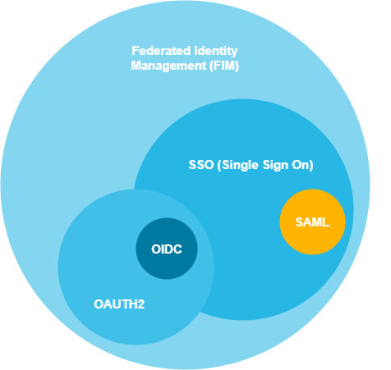
SSO Terminologies
Federated Identity Management (FIM)
OAuth (OAuth 2.0)
OpenID Connect (OIDC)
Security Access Markup Language(SAML)

Slide 12
Federated Identity Management (FIM)
Federated Identity Management, or Identity Federation, is a system that allows users at separate enterprises to use the same verification method for access to applications and other resources.
Each enterprise maintains its own identity management system
Identity management systems are interlinked through a third service (the identity provider)
The third identity provider stores the credentials and serves as a trust mechanism
Once trust is built, the users from different enterprises that authenticate to the FIM, are automatically given access to all resources tied to it.

Slide 13
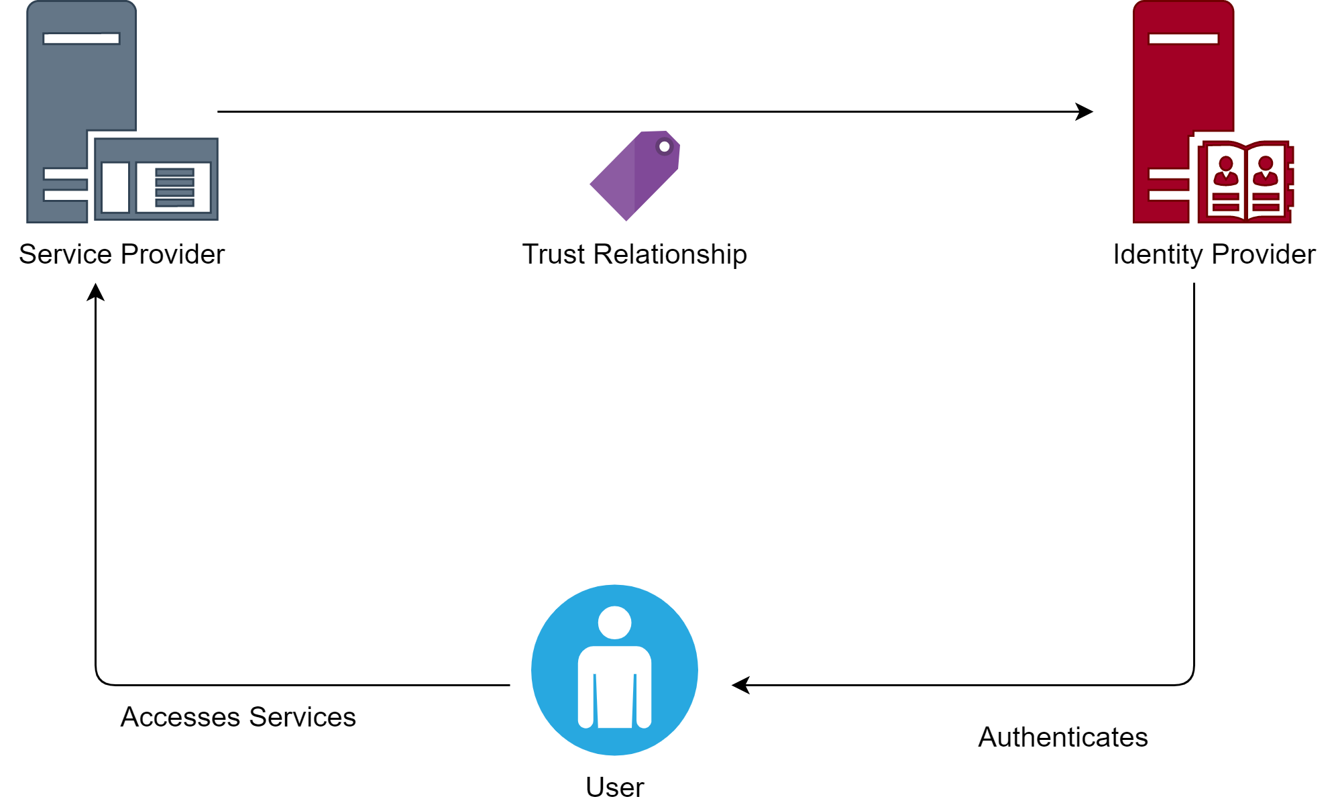
Federated Identity Management (FIM)

Slide 14
OAuth 2.0
OAuth 2.0 is the industry-standard protocol for authorization.
OAuth works over HTTPS and authorizes devices, APIs, servers, and applications with access tokens rather than credentials
OpenID Connect
OpenID is a simple identity layer on top of the OAuth 2.0 protocol.
It allows Clients to verify the identity of the End-User based on the authentication performed by an Authorization Server
Obtains the basic information about the End-User in a Restful manner

Slide 15
Security Access Markup Language
Is an open standard for sharing security information about identity, authentication, and authorization across different systems.
SAML is implemented with the Extensible Markup Language (XML) standard for sharing data
SAML allows business entities to make assertions regarding the identity, attributes, and entitlements of a subject. The subject can be a partner company or another enterprise application.

Slide 16
SSO Software vs SSO Solution vs SSO Provider
SSO Software is something that is installed on-premise. It is usually designed to do a specific set of tasks and nothing else.
SSO Solution suggests that there is the ability to expand or customize the capabilities of the core product
SSO Provider refers to the company that is producing or hosting the solution

Slide 17
SSO Solutions
Some of the popular SSO solutions available in the market are:
Okta
Citrix Workspace
Duo Security
OneLogin
LastPass
Keeper Password Manager

Slide 18
References
https://searchsecurity.techtarget.com/definition/single-sign-on
https://www.cloudflare.com/learning/access-management/what-is-sso/
https://learn.g2.com/single-sign-on-solutions-sso
https://doubleoctopus.com/blog/federated-identity-vs-single-sign-on/
https://developer.okta.com/blog/2017/06/21/what-the-heck-is-oauth
https://openid.net/connect

